Slide 1
Graph Definitions and Notations
Julien Nyambal
Solely From DS Malik Data Structures Using C++ 2nd Edition

Slide 2
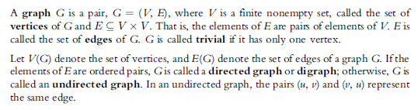
Graph Definitions and Notations
What’s a graph?
Directed and undirected

Slide 3
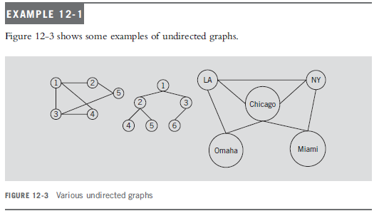
Undirected graph

Slide 4
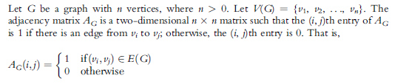
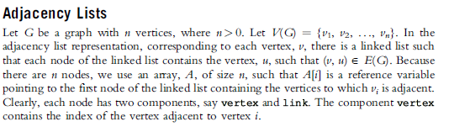
Graph representation
Adjacency Matrices
Adjacency Lists

Slide 5
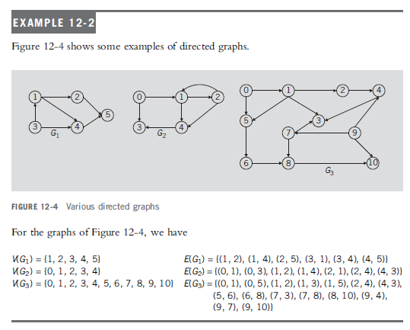
Example directed Graph Adjacency matrix

Slide 6
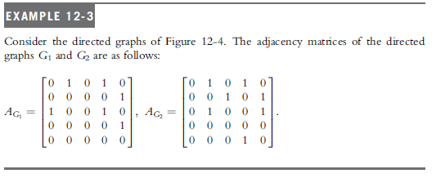
Example directed Graph Adjacency matrix

Slide 7
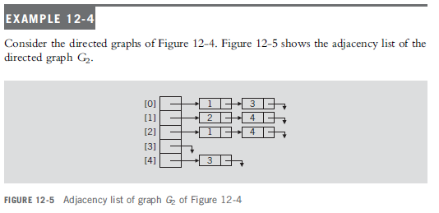
Example directed Graph Adjacency list

Slide 8
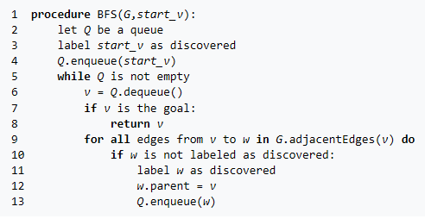
Graph Traversal
BFS

Slide 9
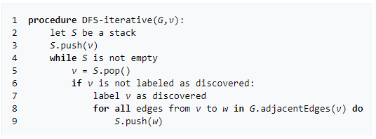
Graph Traversal
DFS

